Slide 1
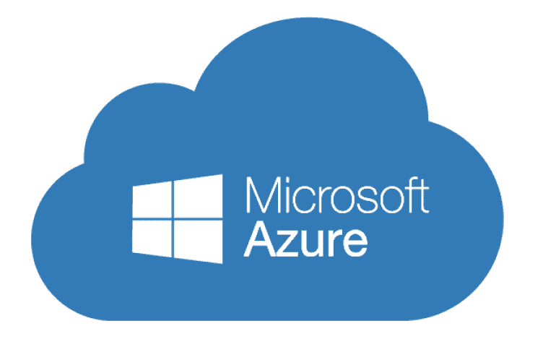
Designing a Resilient Azure 3-Tier Architecture
A Comprehensive Overview
By,
K R Madhumitha

Slide 2
Introduction
The 3-tier architecture is a well-established design pattern for building scalable and maintainable applications.
It divides an application into three interconnected layers, each serving a specific purpose.
Understanding the 3-tier architecture is crucial for designing robust and efficient systems.
Let's delve deeper into each of the three tiers and their significance.

Slide 3
Problem Statement
The 3-tier architecture addresses a range of challenges that organizations face when developing and maintaining software systems.
Scalability is a key concern in modern applications. As user loads increase, systems need to handle more traffic efficiently.
Ensuring security is vital. Protecting sensitive data and preventing unauthorized access is a constant challenge.
High availability is a critical requirement. Downtime can lead to significant financial losses and a poor user experience.
Maintainability is often overlooked. As applications grow, managing and updating them can become complex and costly.
Traditional monolithic systems struggle to meet these demands, leading to issues with performance, security vulnerabilities, and high maintenance costs.
Here we will explore how the 3-tier architecture provides solutions to these problems, offering scalability, security, high availability, and maintainability for modern applications.

Slide 4
Architecture Overview
Presentation Layer (Frontend): This tier is responsible for the user interface and user experience. It includes web servers, where the web application is hosted. In our architecture, it is represented by the Web Tier.
Application Layer (Backend): The application tier handles the business logic and processing. It consists of virtual machines and resources that run application code and provide services to the presentation tier. This tier includes load balancers and virtual machine scale sets to ensure scalability and high availability.
Data Storage Layer (Database): The data tier is responsible for storing and managing data. It often includes database servers, and in our case, our plan to integrate a MySQL server with the web app service to manage our data.
In a three-tier architecture, each layer is independent and communicates with the adjacent layers through well-defined interfaces. This separation of concerns allows for better maintainability, scalability, and flexibility of the application.

Slide 5
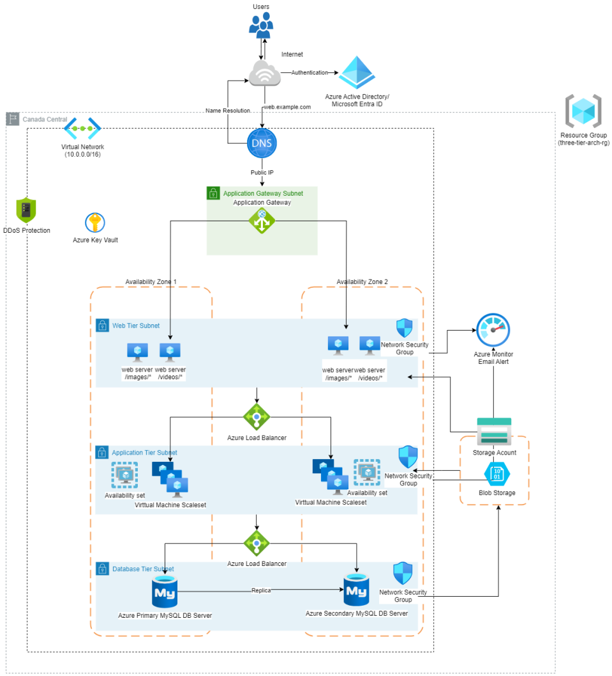

Slide 6
High-Level Architecture Diagram
Outlined the key components and their interactions:
Azure Application Gateway: This component acts as a Layer 7 load balancer, supporting HTTP and routing traffic to the Web Tier.
Web Tier: The Web Tier consists of virtual machines serving web applications. It includes web servers responsible for hosting the web application code.
Load Balancer: The Load Balancer, operating at Layer 4 of the OSI model, routes traffic to the Virtual Machine Scale Set (VMSS) in the Application Tier.
Application Tier: The Application Tier hosts virtual machine scale sets to ensure scalability and high availability for your application logic and processing. Availability Sets ensure that VMs in this tier are distributed across fault and update domains for enhanced resiliency.
MySQL Server: This component represents the database server responsible for managing data used by your web applications.
Database: The Database represents the storage and management of data, typically associated with your web applications.

Slide 7
High-Level Architecture Diagram
DNS: DNS (Domain Name System) manages domain names, including integration with Azure DNS Zone for maintaining A records and associating domain names with the architecture.
Azure Monitor: Azure Monitor provides alerting capabilities, enabling you to receive email alerts when network out bytes exceed certain thresholds, ensuring system health.
Key Vault: Key Vault is used to store sensitive information and secrets, ensuring secure access and management.
Storage Account & Container: The Storage Account and Container are used for storing and managing blob files. These are essential for securely storing various types of data and media files used in your applications.
Microsoft Entra ID/AD: In the Authentication section, I authenticated to the Azure portal and created an application object, generating client IDs and secrets for secure access.
Azure Portal: The Azure Portal represents the web-based interface used for managing and monitoring your Azure resources.

Slide 8
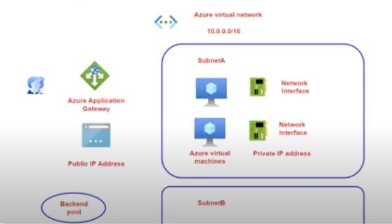
Azure Application Gateway

Slide 9
Azure Application Gateway and Web Tier
Layer 7 Support for HTTP: Application Gateway operates at Layer 7 of the OSI model, providing advanced load balancing and routing capabilities specifically for HTTP/HTTPS traffic.
It provides features such as SSL termination, URL-based routing, session affinity, and web application firewall (WAF) capabilities to enhance the performance, security, and availability of web applications. It also provides SSL/TLS offloading, together with auto scaling (Standard v2) and rich routing rules.
Routing Traffic to Web Tier: Application Gateway routes incoming traffic to the Web Tier, which hosts web servers. It intelligently directs requests to the appropriate virtual machines within the Web Tier based on various criteria.
The Web Tier is a crucial part of the architecture responsible for hosting web servers.
Image and Video Paths: Web servers in the Web Tier host content, including image and video paths, making it accessible to users.
Custom Script Execution: A custom script is executed to install Internet Information Services (IIS) on port 80. IIS enables web server functionality and serves web content to users.

Slide 10
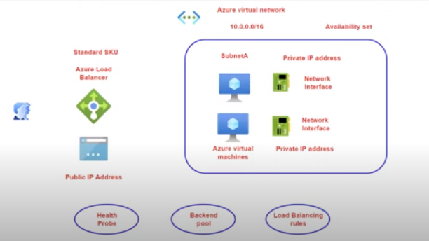
Load Balancer (Layer 4)

Slide 11
Load Balancer and Application Tier
The Layer 4 Load Balancer is an essential component of the architecture, operating at the transport layer of the OSI model. It provides load balancing functionality based on the TCP protocol.
Used to distribute incoming network traffic across multiple VMSS instances for both the frontend and backend tiers, ensuring load balancing and high availability.
This Load Balancer efficiently routes incoming traffic to the Application Tier, ensuring high availability and fault tolerance for the application services in the Application Tier.
The Application Tier is a critical part of the architecture responsible for processing application logic. It ensures the reliability and scalability of application services.
This tier includes a Load Balancer Backend Pool, Health Probe, and Rule. These components work together to distribute incoming traffic effectively across multiple instances in the Application Tier, guaranteeing optimal performance and resilience.
Azure Virtual Machine Scale Sets (VMSS): Used to deploy and manage a group of identical virtual machines for the web and application tier, providing high availability and scalability.

Slide 12
DNS Management
Purchased a domain name from a domain registrar like GoDaddy to establish a unique web address for my resources.
Azure DNS Zone is used to maintain and manage A records, enabling the mapping of domain names to IP addresses.
Linking the load balancer's frontend IP to the domain name: The process of associating the domain name with the frontend IP address of the Load Balancer to make resources accessible via the domain name.

Slide 13
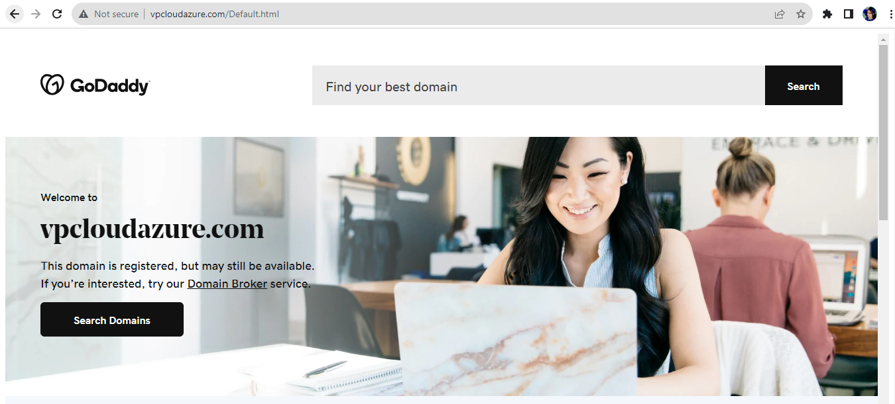
DNS Management

Slide 14
Azure MySQL Database
It is a platform as a service and the complete compute infrastructure is managed for me. Azure provides a fully managed platform for hosting, maintaining, and scaling MySQL databases.
For the Azure mysql database there is a firewall in place, if we need to connect to the mysqldb via internet and via the mysql database server, we need to have a firewall rule in place.
MySQL facilitates the management of user data, session information, and content repositories. It offers robust data integrity features and supports complex queries to retrieve and present data on web applications.

Slide 15
Azure Monitor & Alerts
Azure Monitor is configured to keep an eye on resource health and performance, providing insights into the operation of various Azure services.
Alert for network out bytes exceeding 70 bytes: Alert set up in Azure Monitor to trigger an email notification when network out bytes surpass a defined threshold, in this case, 70 bytes.

Slide 16
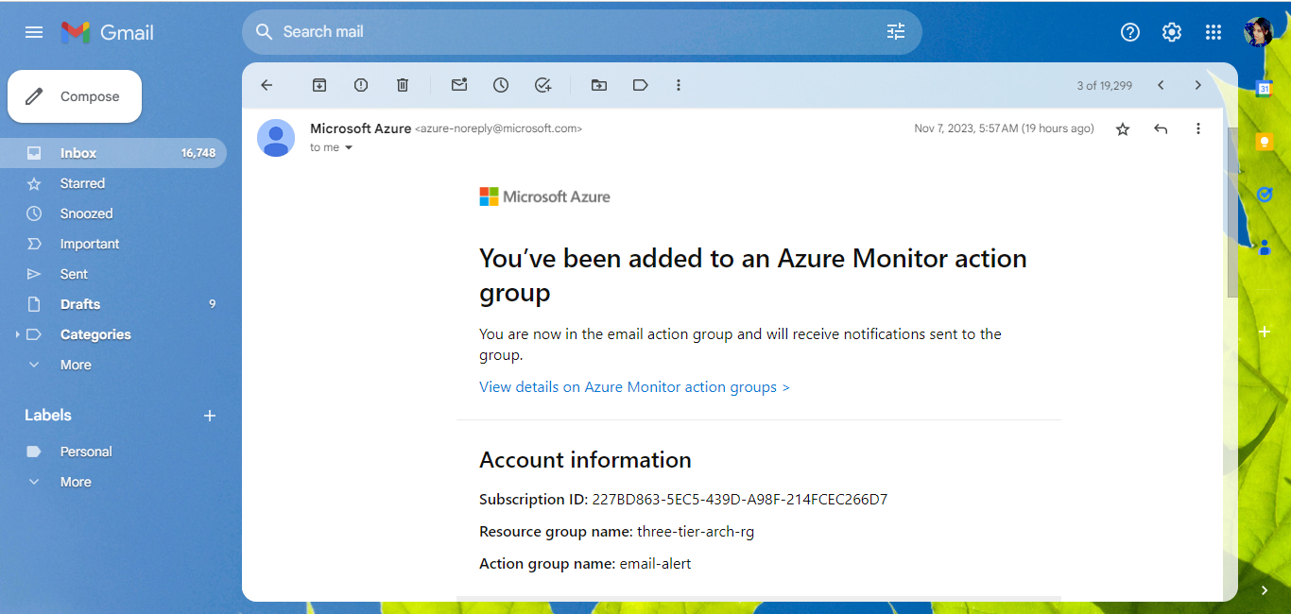
Azure Monitor & Alerts

Slide 17
Key Vault and Azure Portal Authentication
All the keys used are stored in an Azure Key Vault, which is a Hardware Security Model (HSM) solution to protect the data in the cloud.
"Terraform" Application Object is created and is registered in the Azure Active Derectory/Microsoft Entra ID to get the essential information for secure and authenticated access to Azure resources.
Following information are available and same is added in the Terraform template:
Subscription ID
Client ID
Tenant ID
Generating the Client Secret Key

Slide 18
Azure Storage Account
Azure Storage Account is a core service provided by Microsoft Azure for scalable and secure data storage in the cloud. It offers a wide range of data storage services that can be used to store and manage various types of data.
Here, Azure Storage container is used for Blob files to store unstructured data, including documents, images, videos, and backups. It is highly scalable and can serve as a content delivery network (CDN) for distributing content globally.
Azure Storage Account is a central element in our architecture, offering a highly available, secure, and scalable solution for storing and serving multimedia files to the web servers in the Web Tier. It ensures that multimedia content is readily available, easily accessible, and delivered efficiently to users, contributing to an optimal user experience.

Slide 19
Benefits of the Architecture:
Scalability: This architecture is designed to easily scale resources as demand grows. Auto-scaling in the Application Tier and the use of Azure Blob Storage for multimedia files ensure resources adapt to changing requirements.
Reliability: Redundancy and high availability are key features, with data replication in Azure Storage Account and the ability to distribute resources across regions. This minimizes downtime and enhances reliability.
Security: Azure Key Vault, RBAC, and NSGs enhance the overall security posture. Sensitive information is stored securely, and access is strictly controlled, reducing the risk of data breaches.

Slide 20
Conclusion
Key Architecture Points:
Three-Tier Structure: This design promotes separation of concerns, scalability, and efficient resource management.
Network Components: are thoughtfully organized to ensure optimal traffic routing and network security.
Security Measures: The architecture incorporates multiple security measures, including the use of Azure Key Vault for securely storing sensitive data, such as credentials and keys. Role-based access control (RBAC) and Azure Active Directory are utilized to manage and control access. Network security groups (NSGs) and firewall rules are employed to safeguard resources.
Terraform Deployment: The successful deployment of the entire infrastructure using Terraform ensures consistency, repeatability, and version control of our environment.
Future Enhancements and Optimizations:
Enhanced Monitoring, Multi-Region Deployment, DevOps Integration, Data Analytics

Slide 21
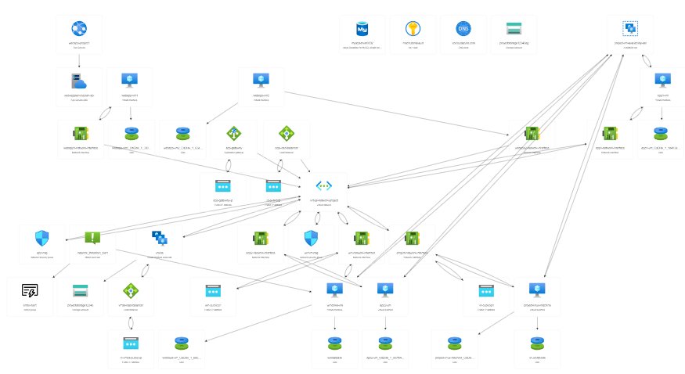
Resource visualizer

